Slide 1
GlyGen Biocuration Project
2026 Summer Volunteership Symposium
POCs: Rene Ranzinger, Urnisha Bhuiyan, Sena Arpinar
July 30th, 10 AM - 1 PM

Slide 2
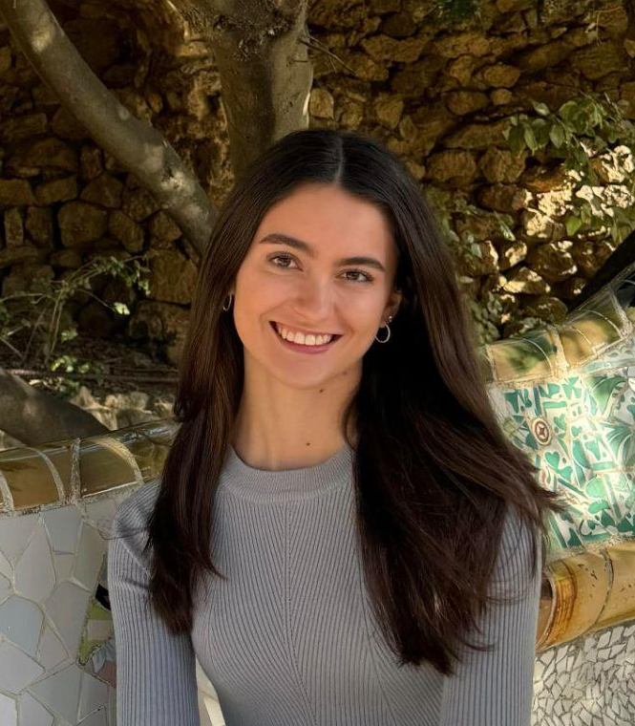
About Me
Undergraduate student at George Washington University
Major: Biology, BS
Minor: Bioinformatics
Fun fact: I have a twin sister
Taylor DiMenna
2

Slide 3
Introduction
Collecting information about glycans, proteins, and their interactions
Some legacy databases are discontinued
Integrating existing data into modern databases (GlyGen) is challenging
Metadata is recorded in free text
Previous volunteers worked to manually curate this data
Was too time consuming
LLM driven approach created to speed up this process
3

Slide 4
Project Goals
Design an LLM prompt to curate species name metadata to their respective scientific name and taxonomy ID within the NCBI database
Write a python script to test this prompt with the human curated data
Match the human curated results to the LLM curated results to progressively improve the prompt
Speed up the process of data curation
4

Slide 5
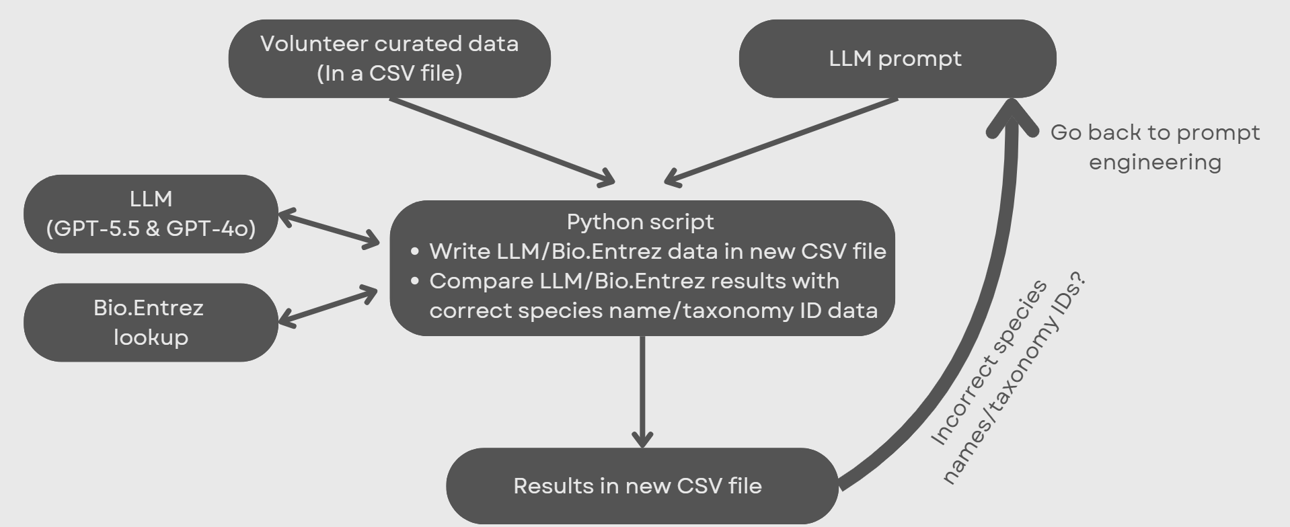
Workflow
5

Slide 6
Workflow
5

Slide 7
Workflow
5

Slide 8
Workflow
5

Slide 9
Workflow
5

Slide 10
CSV File Data Format
Input CSV data
ID | count | name | namespacename | namespaceid | mappingname | rank | matchCount
25267 | 1 | chlorostoma argyostoma turbinatum | Tegula turbinatum | 761901 | chlorostoma argyostoma turbinatum | species | 1
25272 | 1 | polygala klotzchii | Acanthocladus brasiliensis | 2698660 | polygala klotzchii | species | 1
25264 | 1 | codium latum | Codium latum | 221047 |  | species | 1
Output CSV data (added information from LLM and Bio.Entrez Package)
chatgpt_name | name_match_? | ncbi_species_name | ncbi_species_name_ match_? | ncbi_taxon_id | ncbi_taxon_id_ match_?
Tegula turbinatum | Yes | Tegula turbinatum | Yes | 761901 | Yes
Polygala klotzchii | No | Acanthocladus brasiliensis | Yes | 2698660 | Yes
Codium latum | Yes | Codium laum | Yes | 221047 | Yes
6

Slide 11
CSV File Data Format
Input CSV data
ID | count | name | namespacename | namespaceid | mappingname | rank | matchCount
25267 | 1 | chlorostoma argyostoma turbinatum | Tegula turbinatum | 761901 | chlorostoma argyostoma turbinatum | species | 1
25272 | 1 | polygala klotzchii | Acanthocladus brasiliensis | 2698660 | polygala klotzchii | species | 1
25264 | 1 | codium latum | Codium latum | 221047 |  | species | 1
Output CSV data (added information from LLM and Bio.Entrez Package)
chatgpt_name | name_match_? | ncbi_species_name | ncbi_species_name_ match_? | ncbi_taxon_id | ncbi_taxon_id_ match_?
Tegula turbinatum | Yes | Tegula turbinatum | Yes | 761901 | Yes
Polygala klotzchii | No | Acanthocladus brasiliensis | Yes | 2698660 | Yes
Codium latum | Yes | Codium laum | Yes | 221047 | Yes
6

Slide 12
CSV File Data Format
Input CSV data
ID | count | name | namespacename | namespaceid | mappingname | rank | matchCount
25267 | 1 | chlorostoma argyostoma turbinatum | Tegula turbinatum | 761901 | chlorostoma argyostoma turbinatum | species | 1
25272 | 1 | polygala klotzchii | Acanthocladus brasiliensis | 2698660 | polygala klotzchii | species | 1
25264 | 1 | codium latum | Codium latum | 221047 |  | species | 1
Output CSV data (added information from LLM and Bio.Entrez Package)
chatgpt_name | name_match_? | ncbi_species_name | ncbi_species_name_ match_? | ncbi_taxon_id | ncbi_taxon_id_ match_?
Tegula turbinatum | Yes | Tegula turbinatum | Yes | 761901 | Yes
Polygala klotzchii | No | Acanthocladus brasiliensis | Yes | 2698660 | Yes
Codium latum | Yes | Codium laum | Yes | 221047 | Yes
6

Slide 13
CSV File Data Format
Input CSV data
ID | count | name | namespacename | namespaceid | mappingname | rank | matchCount
25267 | 1 | chlorostoma argyostoma turbinatum | Tegula turbinatum | 761901 | chlorostoma argyostoma turbinatum | species | 1
25272 | 1 | polygala klotzchii | Acanthocladus brasiliensis | 2698660 | polygala klotzchii | species | 1
25264 | 1 | codium latum | Codium latum | 221047 |  | species | 1
Output CSV data (added information from LLM and Bio.Entrez Package)
chatgpt_name | name_match_? | ncbi_species_name | ncbi_species_name_ match_? | ncbi_taxon_id | ncbi_taxon_id_ match_?
Tegula turbinatum | Yes | Tegula turbinatum | Yes | 761901 | Yes
Polygala klotzchii | No | Acanthocladus brasiliensis | Yes | 2698660 | Yes
Codium latum | Yes | Codium laum | Yes | 221047 | Yes
6

Slide 14
CSV File Data Format
Input CSV data
ID | count | name | namespacename | namespaceid | mappingname | rank | matchCount
25267 | 1 | chlorostoma argyostoma turbinatum | Tegula turbinatum | 761901 | chlorostoma argyostoma turbinatum | species | 1
25272 | 1 | polygala klotzchii | Acanthocladus brasiliensis | 2698660 | polygala klotzchii | species | 1
25264 | 1 | codium latum | Codium latum | 221047 |  | species | 1
Output CSV data (added information from LLM and Bio.Entrez Package)
chatgpt_name | name_match_? | ncbi_species_name | ncbi_species_name_ match_? | ncbi_taxon_id | ncbi_taxon_id_ match_?
Tegula turbinatum | Yes | Tegula turbinatum | Yes | 761901 | Yes
Polygala klotzchii | No | Acanthocladus brasiliensis | Yes | 2698660 | Yes
Codium latum | Yes | Codium laum | Yes | 221047 | Yes
6

Slide 15
CSV File Data Format
Input CSV data
ID | count | name | namespacename | namespaceid | mappingname | rank | matchCount
25267 | 1 | chlorostoma argyostoma turbinatum | Tegula turbinatum | 761901 | chlorostoma argyostoma turbinatum | species | 1
25272 | 1 | polygala klotzchii | Acanthocladus brasiliensis | 2698660 | polygala klotzchii | species | 1
25264 | 1 | codium latum | Codium latum | 221047 |  | species | 1
Output CSV data (added information from LLM and Bio.Entrez Package)
chatgpt_name | name_match_? | ncbi_species_name | ncbi_species_name_ match_? | ncbi_taxon_id | ncbi_taxon_id_ match_?
Tegula turbinatum | Yes | Tegula turbinatum | Yes | 761901 | Yes
Polygala klotzchii | No | Acanthocladus brasiliensis | Yes | 2698660 | Yes
Codium latum | Yes | Codium laum | Yes | 221047 | Yes
6

Slide 16
CSV File Data Format
Input CSV data
ID | count | name | namespacename | namespaceid | mappingname | rank | matchCount
25267 | 1 | chlorostoma argyostoma turbinatum | Tegula turbinatum | 761901 | chlorostoma argyostoma turbinatum | species | 1
25272 | 1 | polygala klotzchii | Acanthocladus brasiliensis | 2698660 | polygala klotzchii | species | 1
25264 | 1 | codium latum | Codium latum | 221047 |  | species | 1
Output CSV data (added information from LLM and Bio.Entrez Package)
chatgpt_name | name_match_? | ncbi_species_name | ncbi_species_name_ match_? | ncbi_taxon_id | ncbi_taxon_id_ match_?
Tegula turbinatum | Yes | Tegula turbinatum | Yes | 761901 | Yes
Polygala klotzchii | No | Acanthocladus brasiliensis | Yes | 2698660 | Yes
Codium latum | Yes | Codium laum | Yes | 221047 | Yes
6

Slide 17
CSV File Data Format
Input CSV data
ID | count | name | namespacename | namespaceid | mappingname | rank | matchCount
25267 | 1 | chlorostoma argyostoma turbinatum | Tegula turbinatum | 761901 | chlorostoma argyostoma turbinatum | species | 1
25272 | 1 | polygala klotzchii | Acanthocladus brasiliensis | 2698660 | polygala klotzchii | species | 1
25264 | 1 | codium latum | Codium latum | 221047 |  | species | 1
Output CSV data (added information from LLM and Bio.Entrez Package)
chatgpt_name | name_match_? | ncbi_species_name | ncbi_species_name_ match_? | ncbi_taxon_id | ncbi_taxon_id_ match_?
Tegula turbinatum | Yes | Tegula turbinatum | Yes | 761901 | Yes
Polygala klotzchii | No | Acanthocladus brasiliensis | Yes | 2698660 | Yes
Codium latum | Yes | Codium laum | Yes | 221047 | Yes
6

Slide 18
CSV File Data Format
Input CSV data
ID | count | name | namespacename | namespaceid | mappingname | rank | matchCount
25267 | 1 | chlorostoma argyostoma turbinatum | Tegula turbinatum | 761901 | chlorostoma argyostoma turbinatum | species | 1
25272 | 1 | polygala klotzchii | Acanthocladus brasiliensis | 2698660 | polygala klotzchii | species | 1
25264 | 1 | codium latum | Codium latum | 221047 |  | species | 1
Output CSV data (added information from LLM and Bio.Entrez Package)
chatgpt_name | name_match_? | ncbi_species_name | ncbi_species_name_ match_? | ncbi_taxon_id | ncbi_taxon_id_ match_?
Tegula turbinatum | Yes | Tegula turbinatum | Yes | 761901 | Yes
Polygala klotzchii | No | Acanthocladus brasiliensis | Yes | 2698660 | Yes
Codium latum | Yes | Codium laum | Yes | 221047 | Yes
6

Slide 19
CSV File Data Format
Input CSV data
ID | count | name | namespacename | namespaceid | mappingname | rank | matchCount
25267 | 1 | chlorostoma argyostoma turbinatum | Tegula turbinatum | 761901 | chlorostoma argyostoma turbinatum | species | 1
25272 | 1 | polygala klotzchii | Acanthocladus brasiliensis | 2698660 | polygala klotzchii | species | 1
25264 | 1 | codium latum | Codium latum | 221047 |  | species | 1
Output CSV data (added information from LLM and Bio.Entrez Package)
chatgpt_name | name_match_? | ncbi_species_name | ncbi_species_name_ match_? | ncbi_taxon_id | ncbi_taxon_id_ match_?
Tegula turbinatum | Yes | Tegula turbinatum | Yes | 761901 | Yes
Polygala klotzchii | No | Acanthocladus brasiliensis | Yes | 2698660 | Yes
Codium latum | Yes | Codium laum | Yes | 221047 | Yes
6

Slide 20
CSV File Data Format
Input CSV data
ID | count | name | namespacename | namespaceid | mappingname | rank | matchCount
25267 | 1 | chlorostoma argyostoma turbinatum | Tegula turbinatum | 761901 | chlorostoma argyostoma turbinatum | species | 1
25272 | 1 | polygala klotzchii | Acanthocladus brasiliensis | 2698660 | polygala klotzchii | species | 1
25264 | 1 | codium latum | Codium latum | 221047 |  | species | 1
Output CSV data (added information from LLM and Bio.Entrez Package)
chatgpt_name | name_match_? | ncbi_species_name | ncbi_species_name_ match_? | ncbi_taxon_id | ncbi_taxon_id_ match_?
Tegula turbinatum | Yes | Tegula turbinatum | Yes | 761901 | Yes
Polygala klotzchii | No | Acanthocladus brasiliensis | Yes | 2698660 | Yes
Codium latum | Yes | Codium laum | Yes | 221047 | Yes
6

Slide 21
CSV File Data Format
Input CSV data
ID | count | name | namespacename | namespaceid | mappingname | rank | matchCount
25267 | 1 | chlorostoma argyostoma turbinatum | Tegula turbinatum | 761901 | chlorostoma argyostoma turbinatum | species | 1
25272 | 1 | polygala klotzchii | Acanthocladus brasiliensis | 2698660 | polygala klotzchii | species | 1
25264 | 1 | codium latum | Codium latum | 221047 |  | species | 1
Output CSV data (added information from LLM and Bio.Entrez Package)
chatgpt_name | name_match_? | ncbi_species_name | ncbi_species_name_ match_? | ncbi_taxon_id | ncbi_taxon_id_ match_?
Tegula turbinatum | Yes | Tegula turbinatum | Yes | 761901 | Yes
Polygala klotzchii | No | Acanthocladus brasiliensis | Yes | 2698660 | Yes
Codium latum | Yes | Codium laum | Yes | 221047 | Yes
6

Slide 22
Only using GPT-5.5
First Results with Problematic Dataset
33%
17%
17%
Only returned species name matching namespacename
Only returned taxonomy ID matching namespaceid
Both species name and taxonomy ID matching
17%
17%
Returned a species name but no taxonomy ID
Both species name and taxonomy ID returned, but not matching
7

Slide 23
LLM Prompt Progression
Force LLM to return “No Match Found”
Reduce hallucinations/incorrect results
Add correct and failure examples
Better allow the LLM to understand what results are correct
Keep prompt short
Keep token costs low and LLM most productive
Repeat important directions
Repeated statements helped the LLM give more accurate results
8

Slide 24
Final Results on Problematic Dataset
1%
99%
72.5%
GPT-5.5
No Match Found
Species name found
Species name found correctly
92%
8%
GPT-5.5 + Bio.Entrez
Species name + taxon ID correct
Species name + taxon ID incorrect
9

Slide 25
Final Results on Non-Problematic Dataset
1%
99%
98%
GPT-5.5
No Match Found
Species name found
Species name found correctly
100%
0%
GPT-5.5 + Bio.Entrez
Species name + taxon ID correct
Species name + taxon ID incorrect
10

Slide 26
Contributions
Added Bio.Entrez package to pipeline
Additions to LLM prompt to return better results
Solutions to high API tokens/cost
Use GPT-4o for the duration of the project
Switch to GPT-5.5 for final testing
Discovered automatic/manual curation issues from past volunteers
22 rows had automatic mapping errors
Was able to curate 300+ species
Couldn’t do full dataset due to costs
11

Slide 27
Challenges
No prior programing experience
OpenAI often gave unreliable species names/taxonomy IDs
Added Bio.Entrez model to workflow
Large API tokens/cost
Would have been able to curate more species if costs were lower
Had to skip/reschedule meetings due to POC’s having conflicts
12

Slide 28
Next Steps
About 1300 species still need to be matched
Continue using GPT-5.5 with current prompt to achieve this
Accomplish similar curation for cell lines, tissues, and disease identification
13

Slide 29


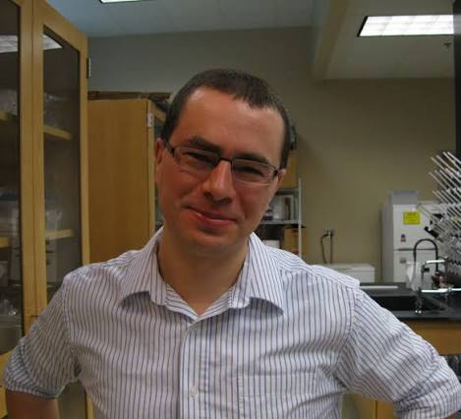


Acknowledgements
Raja Mazumder
George Washington University,
Washington, D.C.
Rene Ranzinger
University of Georgia,
Athens, GA
Urnisha Bhuiyan
George Washington University,
Washington, D.C.
Sena Arpinar
University of Georgia,
Athens, GA
14

Slide 30
Final Results on Problematic Dataset
14%
86%
61.6%
GPT-4o
No Match Found
Species name found
Species name found correctly
86%
14%
GPT-4o + Bio.Entrez
Species name + taxon ID correct
Species name + taxon ID incorrect

Slide 31
Final Results on Non-Problematic Dataset
14%
86%
98.8%
GPT-4o
No Match Found
Species name found
Species name found correctly
100%
0%
GPT-4o + Bio.Entrez
Species name + taxon ID correct
Species name + taxon ID incorrect

